Slide 1
Robobots documentation Training
2026 Competition

Slide 2
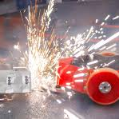



Keys to Success
Follow Instructions - Read the Rubrics
Use the Guidelines Posted in Your Google Drive Folder
Post Your Materials in a Timely Manner
Document EVERYTHING - Minutes, Decision-making Matrices, Timelines, Project Plans and Evidence (Include Photos)
Have Someone Else Review Your Documentation
Does is make sense?
Are there mistakes you didn’t catch?
How would they score it using the rubric?

Slide 3

The Google Drive
Includes rubrics for both the documentation and the interview. Please review to these-this is how you will be scored.
This is also where you will submit your documentation- PLEASE NOTE- there is no requirement to provide a physical binder.

Slide 4
Doing Well in the Interview
Entire Team is Expected to Participate
Make a Good First Impression
You Know the Questions in Advance; be Prepared to Answer Them
You can Bring in Additional Materials, but You may not get to Share Them
You will be Interviewed by a Team of 2-3 Judges for Approximately 15 Minutes
The Top Three Teams from Friday will be Invited back BEFORE the Competition Begins Saturday Morning

Slide 5

Strong Documentation
Don’t Make it Difficult for the Judges!!!

Slide 6

Team Procedures
Documentation Review by Judges
This is how You Keep All of the Information and Materials Collected Throughout the Project Together in a Way that’s Easy to Access and Refer Back to
Is it Easy to Find Items in Your Documentation?
Is it Organized to be Functional for the Needs of the Project?
What the judges look for:
Good: Is the documentation organized and easy to follow?
Excellent: Does the documentation follow the rubric exactly? Is it easy for the judge to find each section?

Slide 7
Design Motivation/Strategy
Influences
If the Team had a Bot the Previous Year:
What was Good about the Bot?
What should be Changed in the Future?
Research Other Robobot/Battle Bot Competitions and the Different Kinds of Bots that Won and Lost to Come Up with Ideas
What the judges look for:
Good: Did the team do research on bots prior to deciding on a design?
Excellent: Does the team show understanding of what has worked in the past and how that affects the design?

Slide 8
Team Procedures Team Management
Every Meeting Held by the Team should have Meeting Minutes:
Topics Discussed
Team Members in Attendance
Date of Meeting
Any Decisions Made at the Meeting
Any Actions from the Previous Meeting Plus New Actions from this Meeting (This should be an Ongoing List with Assignees and Estimated Completion Dates)
Role Management
How did the Team Assign the Roles?
What the judges look for:
Good: Are there meeting minutes (See example on next page)
Excellent: Are the meeting minutes organized and functional to help the team get the work done? Did the team choose roles in a strategic way (i.e., using the team member skill sets) or was it random?

Slide 9

Meeting Minute Template
Attendees:
Date of Meeting:
Decisions made: | Any decisions about the bot or otherwise should be noted.
Topics Covered: | What was done that meeting? i.e. worked on documentation, build rails for bot, tested bot (summarize test), etc
Action | Responsibility | Estimated Completion Date | Status
Action to be done | Who is the ONE person responsible for the action? | When has the responsible person committed to completing the action? Is it early enough for the timeline to remain intact? | If the action goes over several meetings, note the date and then the status at that time in this box. Do not delete previous comments. This gives you history for your documentation
TEAM PROCEDURES
Team Management Example

Slide 10
Team Procedures Material Management Accounting
Material Management
Track all Material Purchased for the Bot. This can be done through Copies of Purchase Orders
A Bill of Material Showing how All of the Material Relates to Each Other (Quantity Needed for the Bot, Location on the Bot, etc.)
What the judges look for:
Good: Are all of the materials listed?
Excellent: Is there a Bill of Material showing how the materials are related?
Accounting/Budget
This should be a Listing of all Expenses Incurred. This can be Tracked during the Project through Purchase Orders, then make a List at the End of the Project to Summarize
Purchase Orders of All of the Material
Purchase Orders of T-shirts/Promotional Materials
What the judges look for:
Good: Is there a Budget?
Excellent: Budget that is Clearly Organized and Money Adds up Correctly

Slide 11
Team Procedures Time Management
Time Management
A Project Plan is Necessary to Make Sure all Aspects of the Project get Completed in Time
MS Excel is a Project Management Tool that can be Used. Be sure to List all Major Steps that Need to Happen
Order T-shirts
Brainstorm Design of Bot
Finalize Design and do CAD Drawing
Order Parts
Build Bot
Test Bot
Complete Documentation
What the judges look for:
Good: Is there a project plan?
Excellent: Does the plan list all actions, including responsibility, comments (any progress or if waiting on another action before it can completed); any indicators that show it was used throughout the project

Slide 12
Item | Priority | Group | Action | Responsibility | Initiation Date | Due Date | Completion Date | Status | Comments
1 | 0 | Design | Research other combat robots and see what design features are preferred. | Team | 15-Oct | 7-Nov | 7-Nov | Complete
2 | 0 | Design | Look at roles and see which one best meets the girls' skills. Have them prioritized. Driver will be determined later | Team | 15-Oct | 7-Nov | 7-Nov | Complete
3 | 2 | Design | Brainstorm design of bot | Team | 7-Nov | 7-Nov | 7-Nov | Complete
20 | 1 | Documents | Promotional/Fundraising Doc | Nia Everett/Emily Salomone |  | 31-Mar |  | Waiting | Waiting on posters
19 | 1 | Documents | Time Management | Reilly Girardot |  | 15-Apr |  | Waiting | Waiting on everything to be finished
33 | 1 | Documents | Testing Results | Alli Kulbago |  | 15-Apr |  | In Process
Team Procedures
Time Management Example

Slide 13
Design Process
Materials of Construction
Show Materials Considered
What the judges look for:
Good: Materials used for Different Parts of Bot
Excellent: Materials used and Factors Evaluated (Strength, Weight, Durability, Cost, Fabrication Ease)
Research Methods
Show the different designs considered
Results of brainstorming Sessions to Determine Design
What the judges look for:
Good: Evidence of Research Done on Design
Excellent: Evidence of other Designs Researched

Slide 14
Design Process (continued)
CAD Models
3D Models from CAD of your Bot Design
What the judges look for:
Good: 3-D Model Available
Excellent: 3-D model with Good Formatting and Labeling of Key Parts to the Bot
Structural Analysis
Pros and cons of your bot design
What the judges look for:
Good: List of strengths and weaknesses of bot design
Excellent: Understanding of bot structure strengths and weaknesses

Slide 15
Design Process (continued)
Engineering Drawings Set
These Drawings should come from CAD, and should Include Dimensions on Fabricated Parts and the Specific Parts Used (i.e., Specs of Motors, Screw Specifications, etc.)
What the judges look for:
Good: CAD drawing of finished bot
Excellent: Set of CAD drawings that includes finished bot, plus any parts that had to be made
Weapon System Details
Description of the Weapon on the Bot with Advantages and Possible Disadvantages
What the judges look for:
Good: A clear description of the weapon
Excellent: Evidence of why the weapon was chosen- advantages/disadvantages

Slide 16
Design Process (continued)
Drive System Details
Description of the choice of drive systems, and why it was chosen over others
What the judges look for:
Good: A clear description of the drive system
Excellent: Evidence of why the drive system was chosen- advantages/disadvantages
Power System Details
Description of the choice of power systems, and why it was chosen over others
What the judges look for:
Good: A clear description of the power system
Excellent: Evidence of why the power system was chosen- advantages/disadvantages

Slide 17
Design Process (continued)
Wiring Schematic
Drawing (could be in CAD or other Software Programs Available Online) of the Bot Electrical Wiring
What the judges look for:
Good: Wiring diagram
Excellent: Wiring diagram that is done digitally that is clear and well-marked

Slide 18
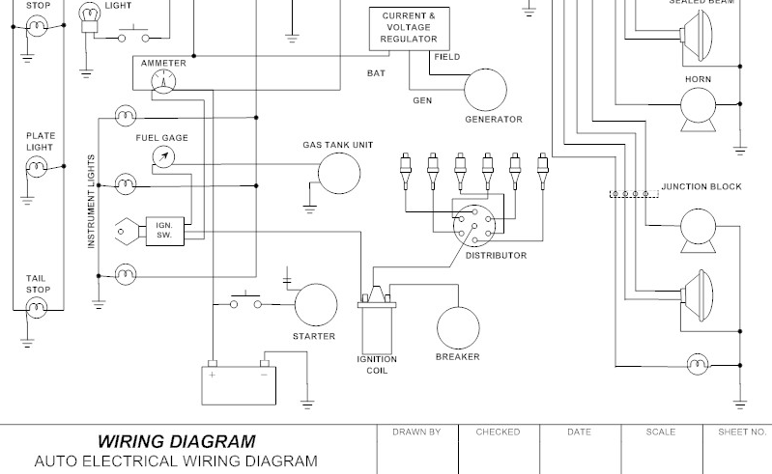
Design Process Wiring Schematic Example

Slide 19
Design Process (continued)
Manufacturing Plans / Assembly Process
Written Procedure to Show how to Assemble the Bot. This should Include Pictures with Indicators of Where the Pieces go
Describe the Ease or Lack thereof for the Bot Assembly/Disassembly
What the judges look for:
Good: 3-D CAD model and written instruction on how to build the bot
Excellent: Clear instructions with pictures that are easy to follow

Slide 20
Design Process (continued)
Testing Results
Tests should be via the Scientific Method.
Results should be Quantifiable and Documented.
If Possible, Multiple, Tests should be Run to Ensure Repeatability of the Bot Performance
What the judges look for:
Good: Description of testing and results
Excellent: Evidence of Aggression, Durability, and maneuverability testing. Quantifiable results presented in a neat data-driven format
Design Refinement
List what refinements were done based on the risk analysis and testing
What the judges look for:
Good: List of refinements
Excellent: Risk analysis (see example on next page)or some sort of evidence of analysis of weak points of bots and fixes done to eliminate or minimize those weaknesses

Slide 21
 |  | Existing Conditions
Item and Function | Potential Failure Mode | Potential Effect(s) of Failure | Potential Cause of Failure | Severity | Occurrence | Detection | RPN | Current Controls and/or Recommended Actions
Spinner | Could catch and break a belt | No weapon | Debris | 4 | 5 | 1 | 20 | Extra Belts
Remote Control | Batteries could die | Loss of Function | Weak batteries Something is pulling too much power | 5 | 1 | 4 | 20 | Extra batteries
Remote Control | Switch in wrong position | Weapon wouldn’t move | Not putting it back in starting position | 2 | 1 | 1 | 2 | Turn it off and turn it back on
DESIGN PROCESS (CONTINUED)
Refinement Example
Look up FMEA Online to get a Template for this

Slide 22

QUESTIONS
What Questions do You have?

